Slide 1
IBM Data Science Capstone Project
Space X Falcon 9 Landing Analysis

Slide 2
OUTLINE
Executive Summary
Introduction
Methodology
Result
Conclusion
Appendix

Slide 3
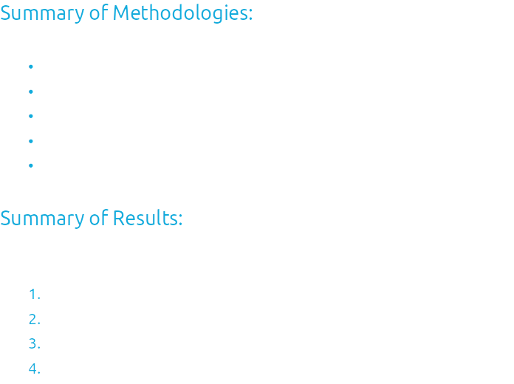
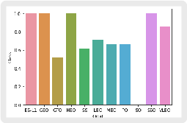
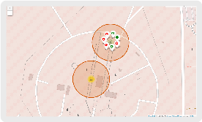
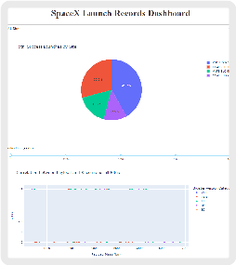
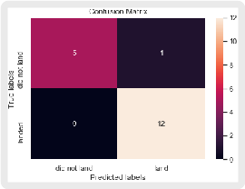

Slide 4
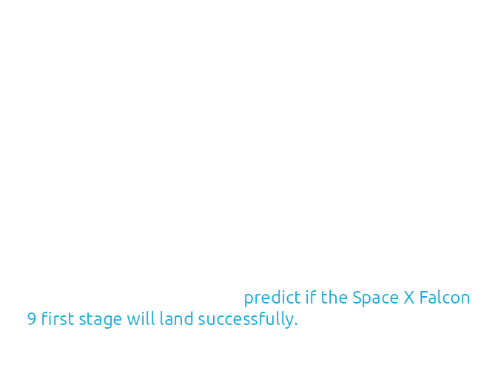
Introduction

Slide 5
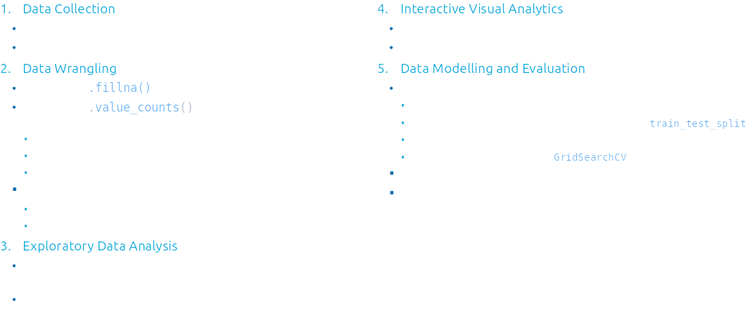
Methodology summary

Slide 6

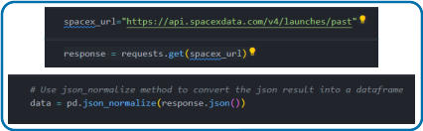
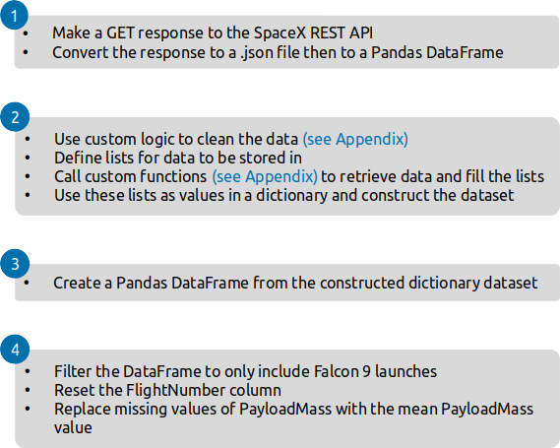
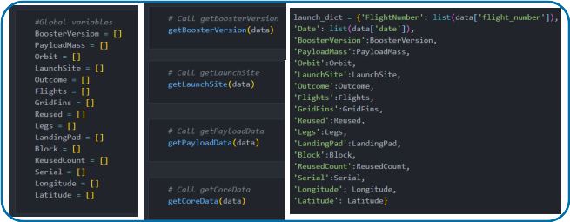
DATA COLLECTION – space x REST api

Slide 7
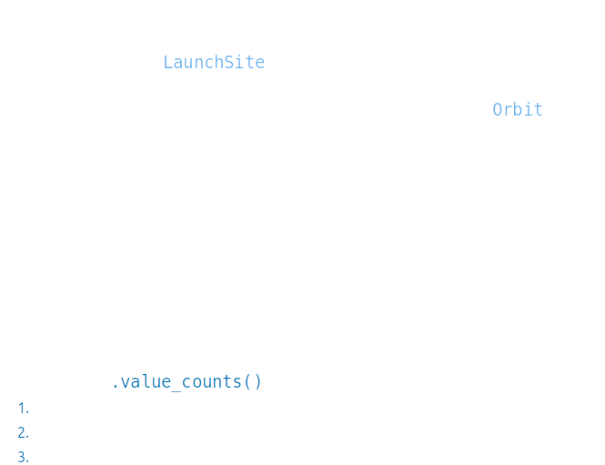
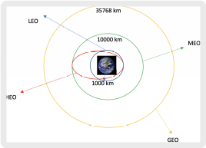
Data Manipulation

Slide 8

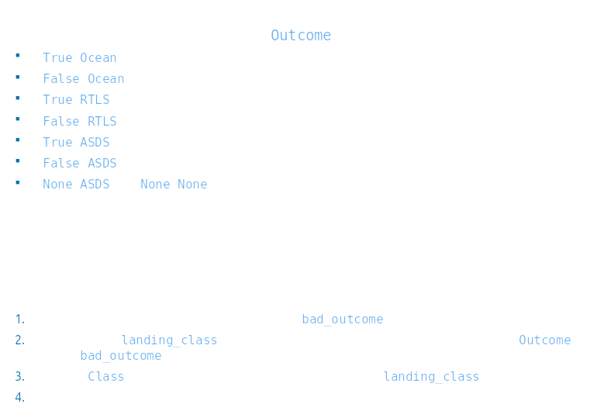
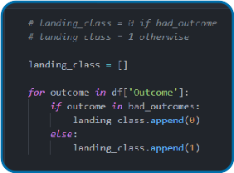

DATA MANIPULATION/WRANGLING – PANDAS

Slide 9
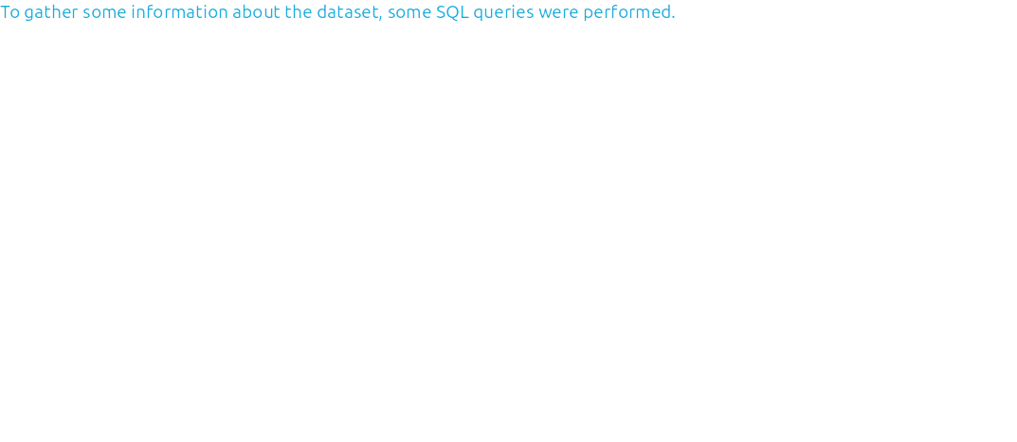
Exploratory data analysis (eda) – SQL

Slide 10
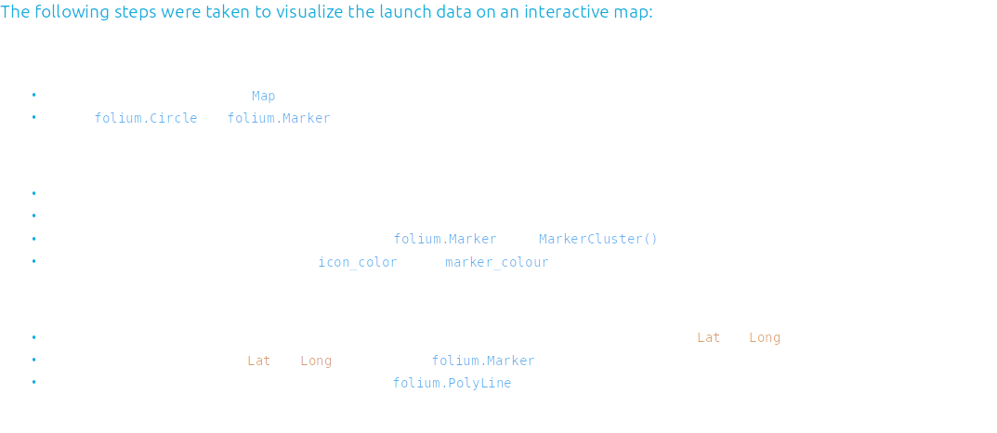
Geospatial analysis – folium

Slide 11
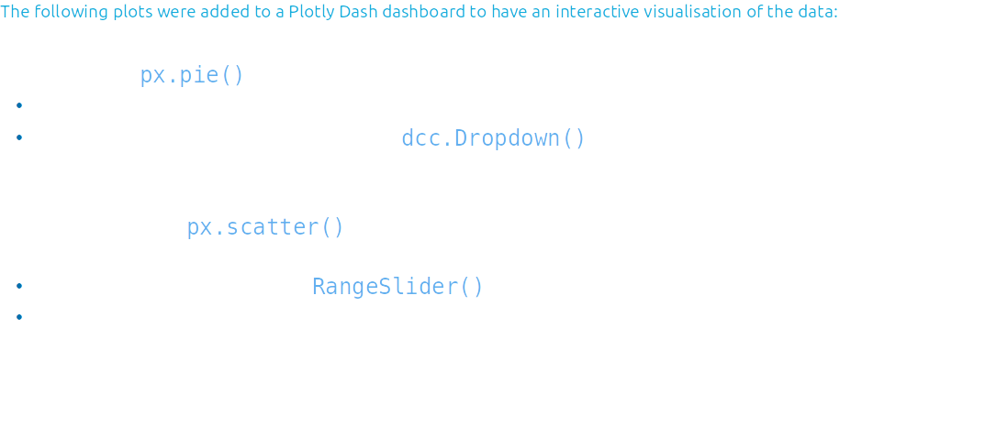
Interactive dashboard – plotly dash

Slide 12

Predictive Analysis - Classification

Slide 13



results

Slide 14

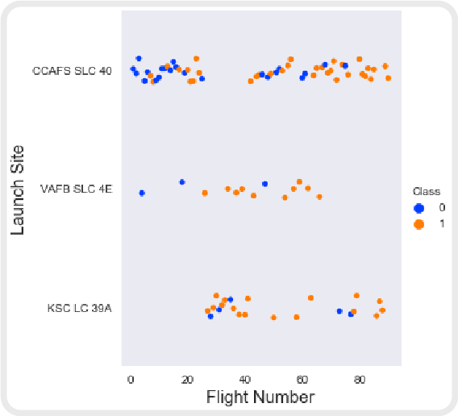
Launch Site VS. FLIGHT NUMBER

Slide 15

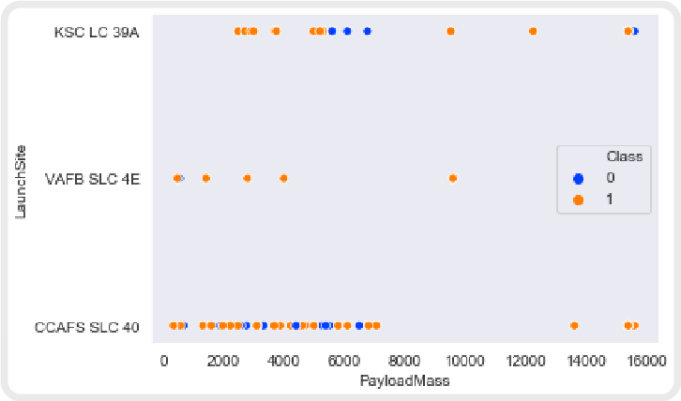
LAUNCH SITE vs. PAYLOAD MASS

Slide 16

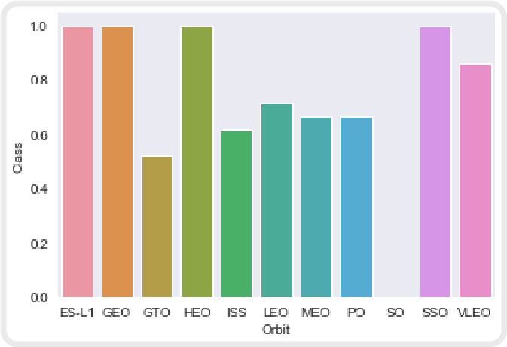
Success Rate vs. Orbit Type

Slide 17

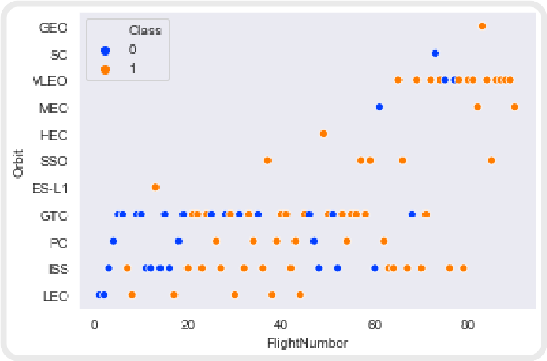
Orbit Type vs. flight number

Slide 18

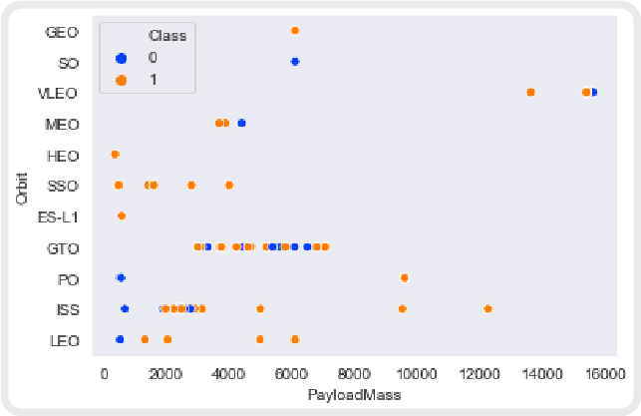
ORBIT TYPE VS. PAYLOAD MASS

Slide 19

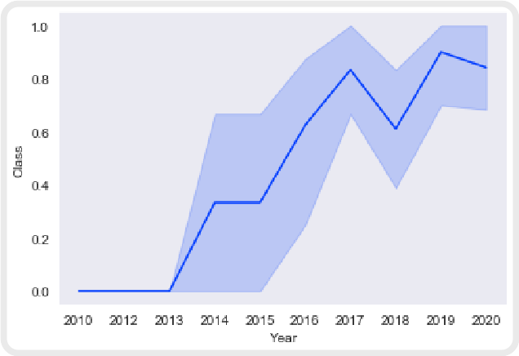
Launch Success Yearly Trend

Slide 20
LAUNCH SITES PROXIMITY ANALYSIS – FOLIUM INTERACTIVE MAP

Slide 21
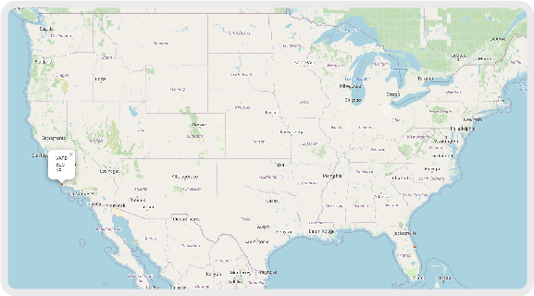
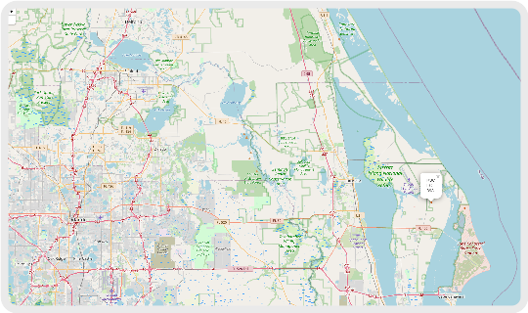
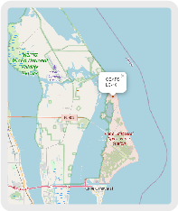
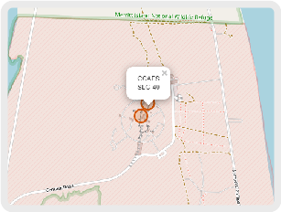
ALL LAUNCH SITES ON A MAP

Slide 22
interactive dashboard - Plotly Dash

Slide 23
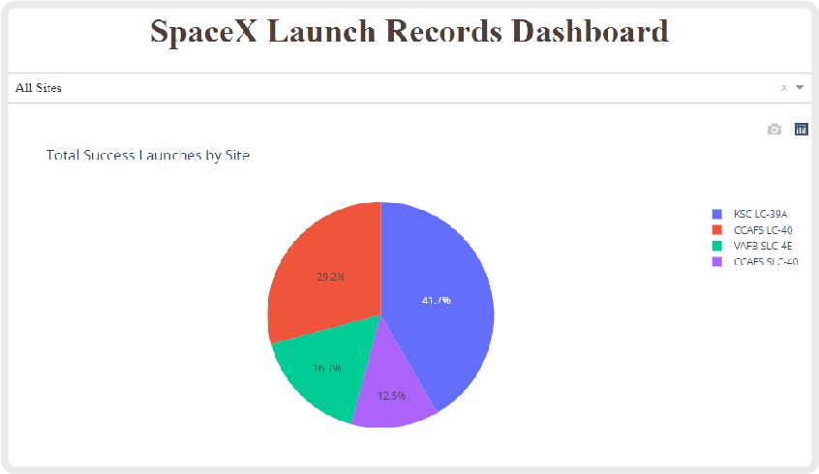
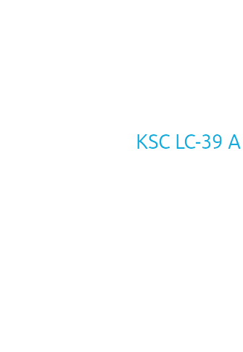
launch success count for all sites

Slide 24
PREDICTIVE ANALYSIS - CLASSIFICATION

Slide 25

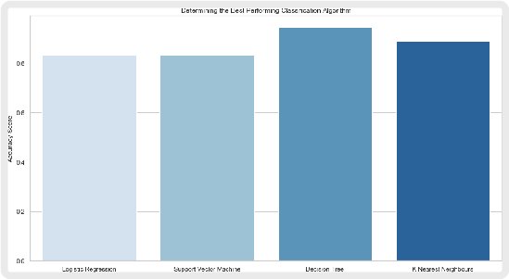
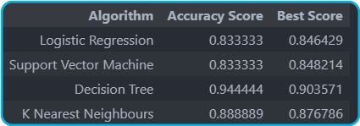
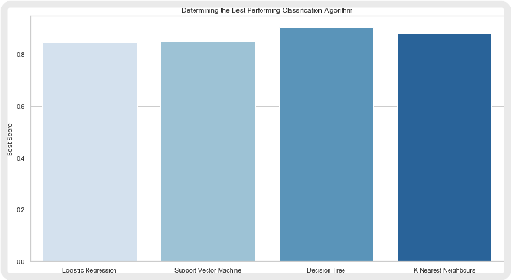
CLASSIFICATION ACCURACY

Slide 26
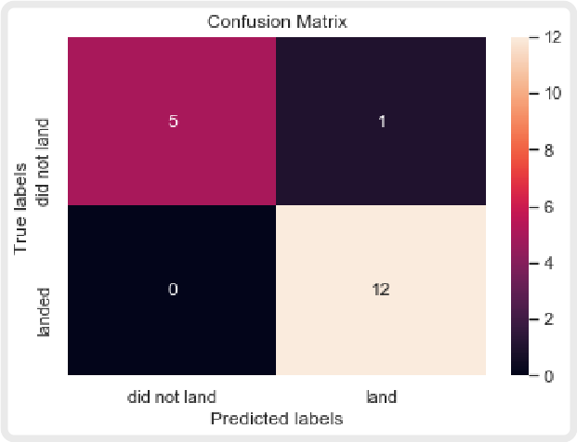

Confusion Matrix

Slide 27
CONCLUSIONS

Slide 28
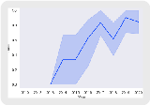

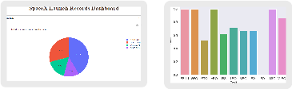
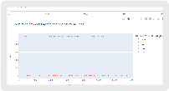
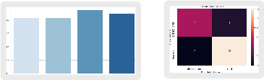
CONCLUSIONS

